Slide 1
BEYBLADE
METAL FUSION
Done by
m.j.n.v.sai

Slide 2
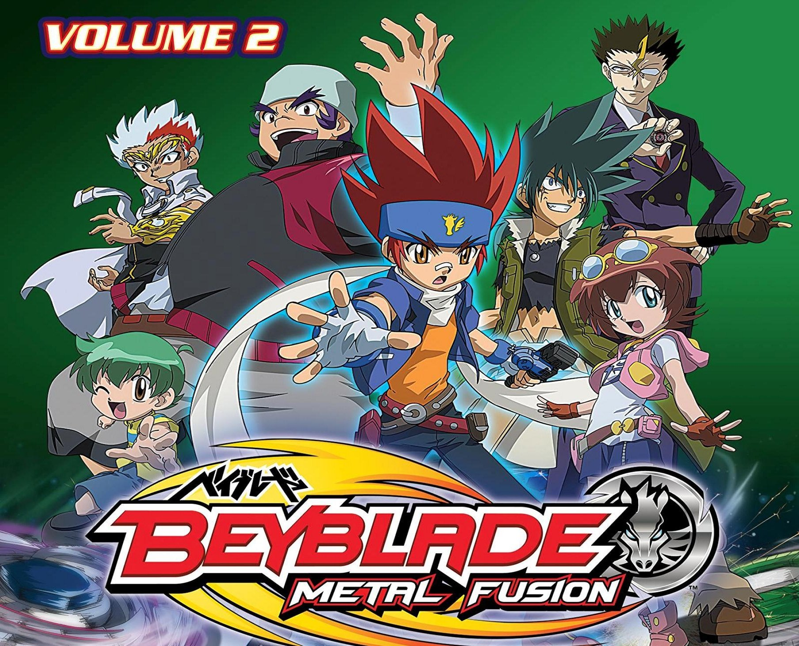

Slide 3
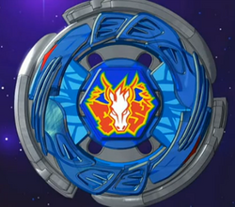
Gingka is known worldwide for saving the world on three occasions: ending Lightning L-Drago 100HF's dark power corruption of Ryuga and the Dark Nebula Organization during the final battle of the Battle Bladers tournament
GINGKA HAGANE HOLDING THE STORM PEGASUS

Slide 4
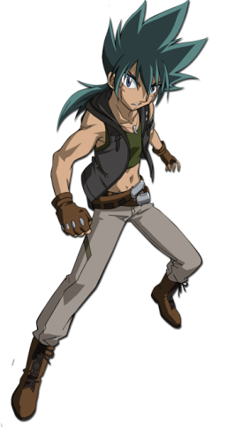
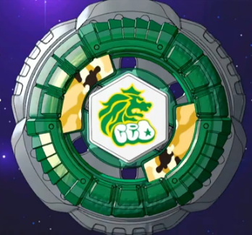
KYOYA TATEGAMI
He is one of Gingka Hagane's greatest rivals and was the former leader of the Face Hunters. However, after losing to Gingka, he decided to disband the group and eventually joined Gingka and his friends on several occasions.
BEYBLADE :
ROCK LEONE

Slide 5
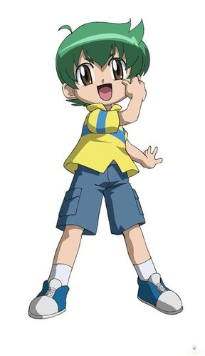
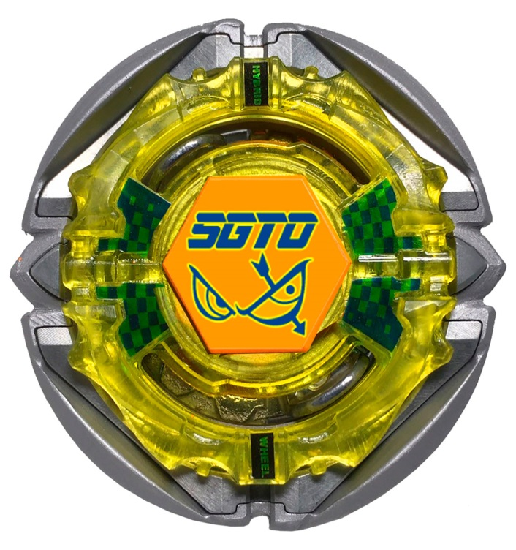
KENTA YUMIYA
He is one of Gingka Hagane's friends and goes to many lengths to support him. He is also friends with Madoka Amano, Benkei Hanawa, Yu Tendo, Tsubasa Otori, Kyoya Tategami and Ryuga. Kenta was formerly the owner of Flame Sagittario C145S and currently owns Flash Sagittario 230WD.
BEYBLADE :
FLAME SAGITTARIO

Slide 6
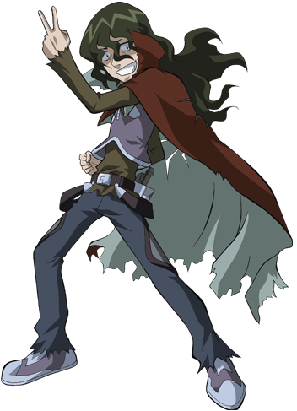
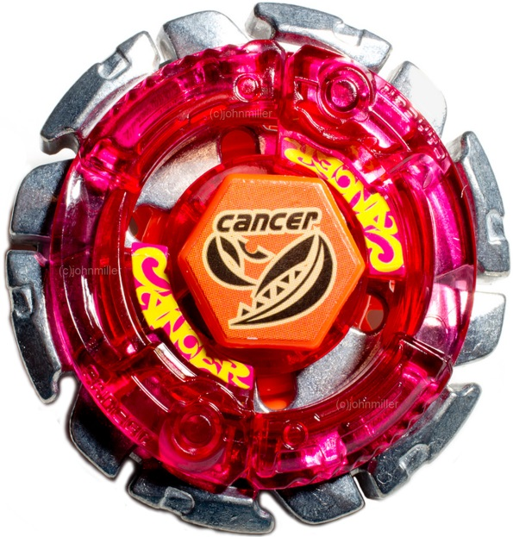
TETSUYA WATARAGAMI
He is a mysterious blader with an insane personality with an undying love for his former Bey; Mad Gasher CH120FS. He also cheats to make his opponents think that he is strong, but it doesn't work anymore. He is obsessed with crabs.
BEYBLADE :
DARK GASHER

Slide 7
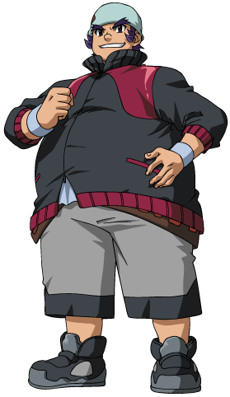
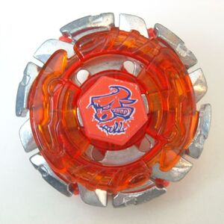
BENKEI HANAWA
He is a former member of the Face Hunters under the leadership of Kyoya Tategami. He and Kyoya later reformed and became best friends, Benkei always supporting Kyoya from the sidelines hoping to be right next to him when it counts
BEYBLADE :
DARK BULL

Slide 8
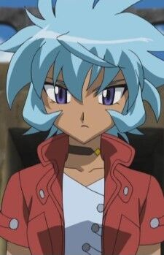
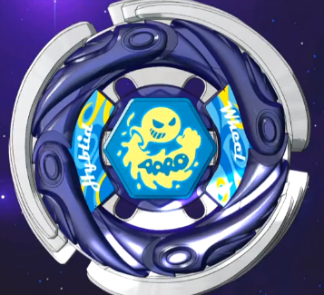
HIKARU HASAMA
Hikaru became such a cold, uninterested Beyblader because other Bladers kept destroying her hopes to be a good player in tournaments. When she was beaten miserably, she would break down crying while the other boy would just smirk. Her mother though, apparently ill, convinced her that she should never abandon her goal and that determination is everything. Her mother herself dreamed of becoming a strong Blader and declared that Hikaru was her legacy.
BEYBLADE :
STORM AQUARIO

Slide 9
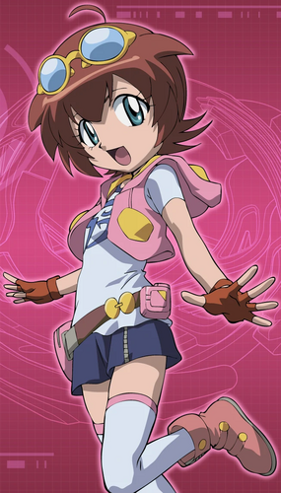
MADOKA AMANO
Amano Madoka is the unofficial deuteragonist of the Metal Saga anime and is also featured in the manga series. She is the daughter of the manager that owns B-Pit. During her time there, she repairs and analyzes Beyblades. she lives with her father, the owner of the B-Pit. At some point, she started helping out in the shop and by the time of her introduction she does a lot of the work, while her father is never seen.

Slide 10
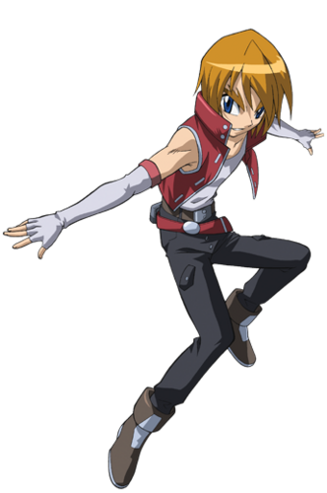
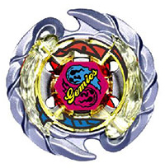
DAN SODO
Sodo Dan is a member of the Dark Nebula. His twin is Reiki Sodo, and they share Evil Gemios DF145FS. Dan wears red and is the more mature brother. Dan prefers to save his Stamina rather than Attack.
BEYBLADE :
EVIL GEMIOS

Slide 11
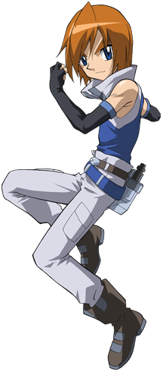
REIKI SODO
Sodo Reiki is a member of the Dark Nebula. His twin is Dan Sodo, and they both own Evil Gemios DF145FS. Reiki wears blue and is the immature brother.
BEYBLADE :
EVIL GEMIOS

Slide 12
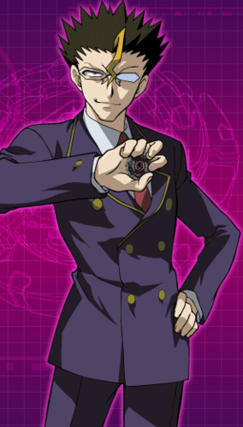
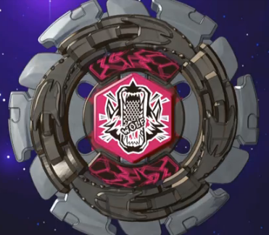
DOJI
He was an enemy of Gingka Hagane and the former leader of Dark Nebula who had Ryuga. He used to own Dark Wolf DF145FS. Doji seeked the power of the "Forbidden Bey", Lightning L-Drago 100HF.
BEYBLADE :
DARK WOLF

Slide 13
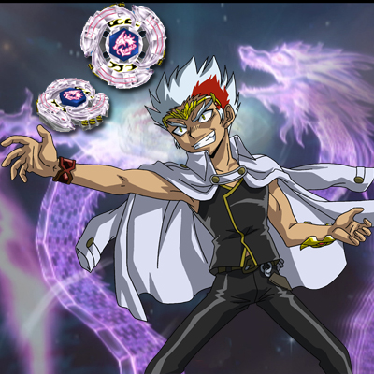
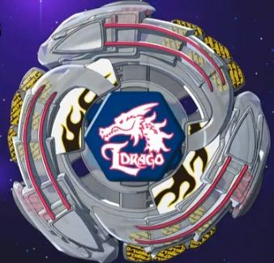
RYUGA (DRAGON EMPEROR)
The leader of the Dark Nebula, Ryuga is a sworn enemy of the Gingka. Ryuga has been in a coma for years, but it is stirred by the Presence of Gingka and Strom Pegasus. Vicious, merciless,and hostile,Ryuga sucks the power from his oppenents. His goal is to obsorb the huge amout of the power from pegasus and turn into its own power L-drago to full power expose the darkness into the world and turn into dark world.
BEYBLADE :
LIGHTNING L-DRAGO

Slide 14
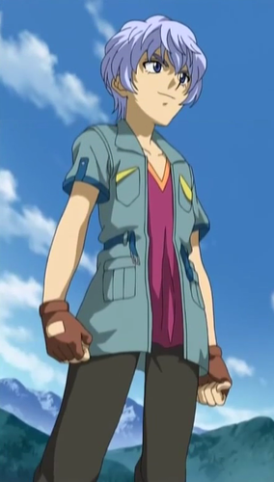
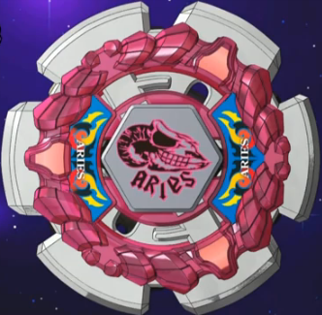
HYOMA
Hyoma remained in Koma Village for the remainder of his life and took up the role of its guardian, not allowing untrustworthy people anywhere near it. He originally came off as a mysterious character and is Gingka's childhood friend and later an ally of Gingka and his friends. He is a deceptive Blader that uses Rock Aries ED145B.
BEYBLADE :
ROCK ARIES

Slide 15
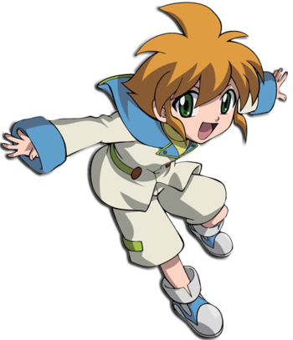
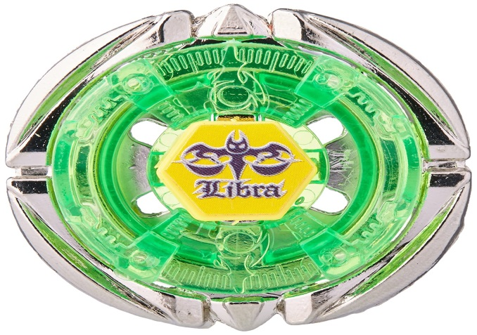
YU TENDO
Yu Tendo is a major character in the Metal Saga, making his debut in Beyblade: Metal Fusion and was Gingka Hagane's first opponent in the Battle Bladers, as well being a creator of the tournament right after he won the Survival Battle.
Yu is a genius Blader who just wants to have fun with his Beyblade Flame Libra T125ES. He is a former member of the Dark Nebula,
who separated from them after they turned on him and tried to destroy his Libra. Soon after that, he made friends with Gingka Hagane,
BEYBLADE :
FLAME LIBRA

Slide 16
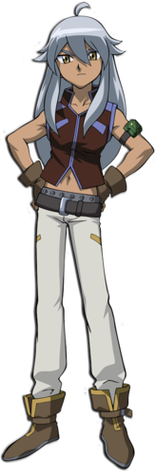
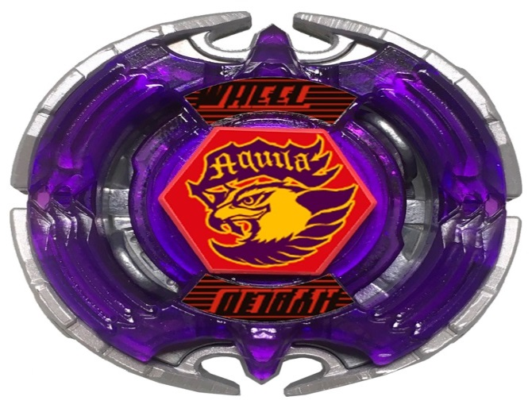
Tsubasa otori
He is a secret-agent of the WBBA who went undercover within the Dark Nebula before the events of Battle Bladers.
Tsubasa is a strong Blader who is generally self-possessed, kind, intelligent, strong, adaptable, nomad, honest. He is a strong tactician who is very adaptable especially during tough points in a battle and utilizes all his senses during battles.
BEYBLADE :
EARTH EAGLE

Slide 17
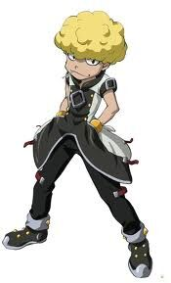
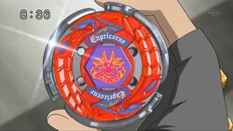
TOBIO OIKE (CAPTAIN CAPRI)
He is a former member of the Dark Nebula and is known as Captain Capri. He is a master sniper with great aim using his Storm Capricorn M145Q.
Tobio is a very persistent and does not let his target get out of his sights until he claims victory. His personality is matched to that of a soldier, and when he assigns himself to a mission he will not fail (at least that's what he thinks)
BEYBLADE :
Storm Capricorne

Slide 18
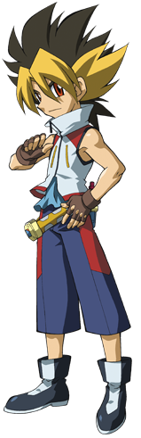
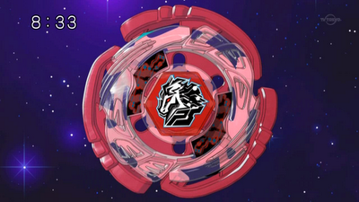
Sora Akatsuki
Sora is an impulsive and intense Blader when partnered with his Cyber Pegasus 100HF. He took part in a Battle Bladers Challenge Match and befriended Kenta, which led him to meet Gingka, and together, they defeated a local gang leader named Busujima. He claims to be Gingka's number 1 apprentice.
BEYBLADE :
CYBER PEGASUS

Slide 19
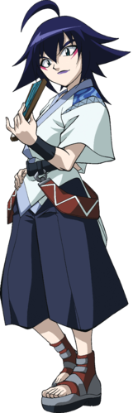
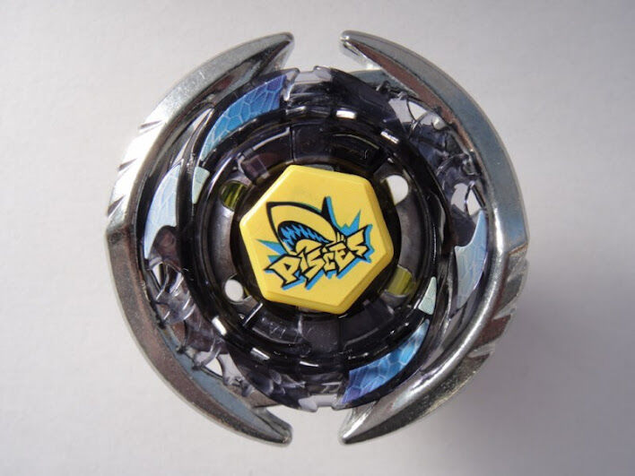
RYUTARO FUKAMI
He was a member of the Dark Nebula and a ruthless Blader fighting with the Bey Thermal Pisces T125ES. His special ability is foreseeing the future, although nothing is known on how concrete and accurate his visions truly are.
Ryutaro is a boy who always puts on a humble facade, even if in truth he is rather arrogant and self-centered. His speech seems overly polite and old-fashioned and he doesn't usually voice a negative opinion directly.
BEYBLADE :
THERMAL PISCES

Slide 20
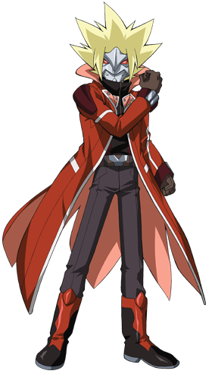
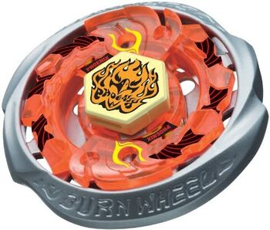
PHONIX ( AS RYU HAGANE)
HE IS THE MYSTERIOUS ALTER EGO OF THE
RYO HAGANE, WHO WHATCHED OVER
GINGKA’S GANG.
EVEN SO PHEONIX IS A POWERFUL BLADER
WHO TURNS HIS ENIMES INTO ASHES
WITH HIS BEY BURN FIREBLAZE 135MS
BEYBLADE :
BURN FIREBLAZE

Slide 21
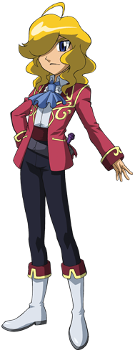
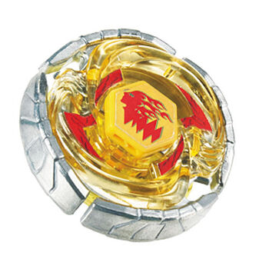
TERU SAOTOME
He is a butter boy who used to be a skilled ballet dancer, he now uses both in unison with his Earth Virgo GB145BS.
In general, Teru is very calm and disciplined. He plays with interest, but also with clear goals in mind, such as getting his name known at least in the Beyblade world.
He does not really talk a lot, but when he does, his words drip with content, and he likes ballet.
BEYBLADE :
EARTH VIRGO

Slide 22
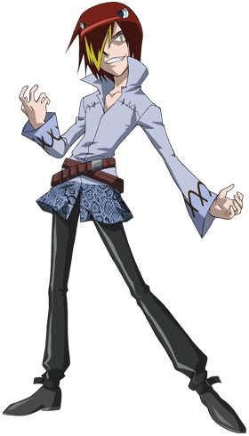
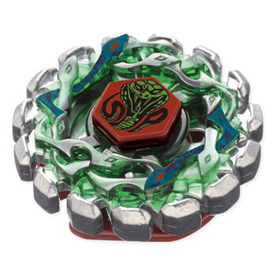
REIJI MIZUCHI
He is a member of the Dark Nebula, being their true second most powerful Blader after Ryuga.Initially, he was assigned to watching over Gingka Hagane to study his Storm Pegasus 105RF. He later takes part in the Battle Bladers tournament; he follows a strategy of attacking opponents weakly to lower their guard and injecting "poison" , when they become vulnerable to the ultimate assault of his Poison Serpent SW145SD.
BEYBLADE :
POISON SERPENT

